Slide 1
Deadlocks
Dr. Tarunpreet Bhatia
Assistant Professor, CSED
TIET

Slide 2
Disclaimer
This is NOT A COPYRIGHT MATERIAL
Content has been taken mainly from the following book:
Operating Systems Concepts By Silberschatz & Galvin

Slide 3
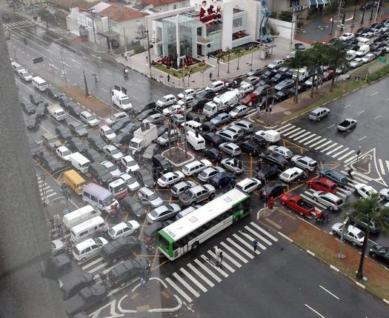
Deadlock – Real Life Scenario

Slide 4
System Model
Resource types R₁, R₂, . . ., R_{m}
CPU cycles, memory space, I/O devices
Each resource type R_{i} has W_{i} instances.
Each process utilizes a resource as follows:
request
use
release

Slide 5
Deadlock Characterization
Mutual Exclusion: only one process at a time can use a resource.
Hold and Wait: a process holding at least one resource is waiting to acquire additional resources held by other processes.
No Preemption: a resource can be released only voluntarily by the process holding it, after that process has completed its task.
Circular Wait: there exists a set {P₀, P₁, …, P_{n}} of waiting processes such that P0 is waiting for a resource that is held by P₁, P₁ is waiting for a resource that is held by
P₂, …, P_{n–1} is waiting for a resource that is held by
P_{n}, and P₀ is waiting for a resource that is held by P₀.

Slide 6
Resource Allocation Graph (RAG)
A set of vertices V and a set of edges E.
V is partitioned into two types:
P = {P1, P2, …, Pn}, the set consisting of all the processes in the system.
R = {R1, R2, …, Rm}, the set consisting of all resource types in the system.
request edge – directed edge Pi → Rj
assignment edge – directed edge Rj → Pi

Slide 7
Representation
Process
Resource Type with 4 instances
Pi requests instance of Rj
Pi is holding an instance of Rj
P_{i}
P_{i}

Slide 8
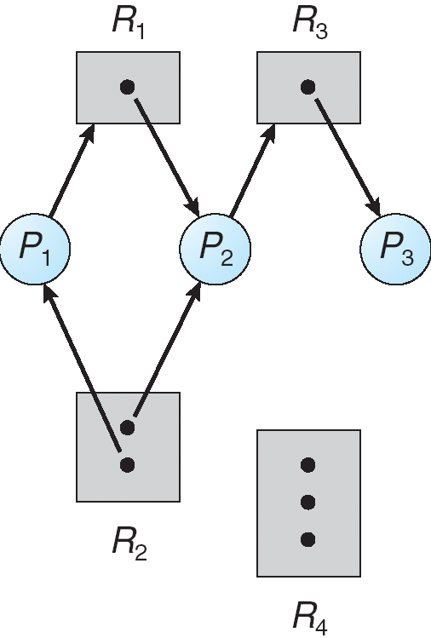
Example - RAG

Slide 9
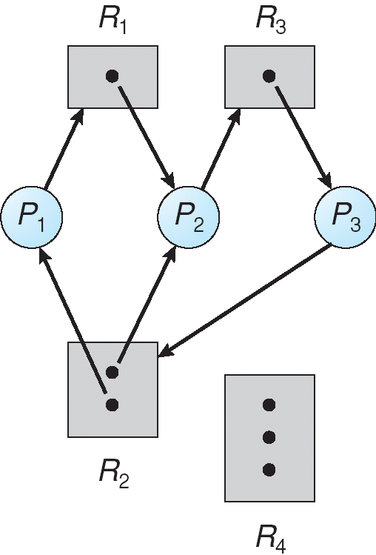
RAG with Deadlock

Slide 10
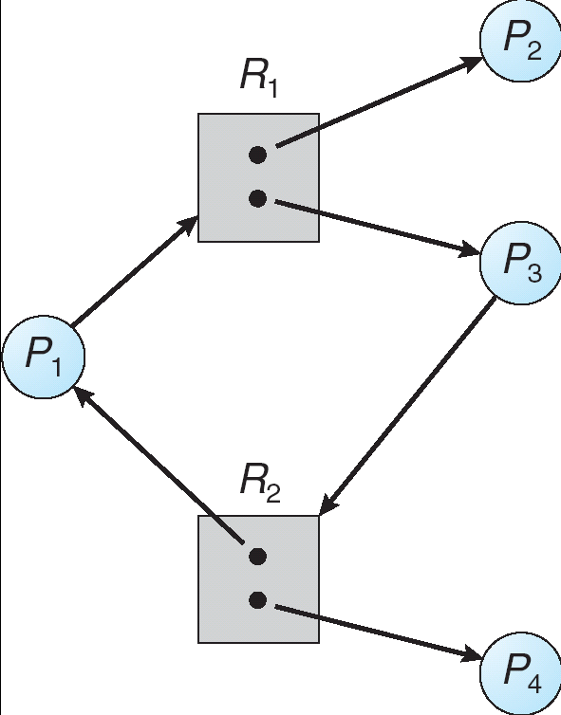
RAG with no Deadlock

Slide 11
Basic Facts
If graph contains no cycles ⇒ no deadlock.
If graph contains a cycle ⇒
if only one instance per resource type, then deadlock.
if several instances per resource type, possibility of deadlock.

Slide 12
Deadlock Prevention
Mutual Exclusion – not required for sharable resources; must hold for non sharable resources.
Hold and Wait – must guarantee that whenever a process requests a resource, it does not hold any other resources.
Require process to request and be allocated all its resources before it begins execution, or allow process to request resources only when the process has none.
Low resource utilization; starvation possible.

Slide 13
No Preemption
Method 1: preempting the resources of a process (and then restarting the process or reallocating resources to it) if its request cannot be granted.
Method 2: preempting the resources of a process (and then restarting the process or reallocating its resources) if it holds some resource that is being requested
Problems
State of resource must be saved and restored
Difficult for resources whose state cannot be saved and restored

Slide 14
Circular Wait
Impose total ordering on resource types. Require that process requests resources in an increasing order of enumeration.
Problems
– for best efficiency, resource numbers must correspond to expected order of use of resources. If use is out of order, the result is idle resources (waste)
– Large effect on system programs
change in resource numbers may require change in program
programmer has to be aware of ordering in structuring program
portability of program compromised

Slide 15
Safe State
When a process requests an available resource, system must decide if immediate allocation leaves the system in a safe state
System is in safe state if there exists a sequence <P₁, P₂, …, P_{n}> of ALL the processes in the systems such that for each P_{i}, the resources that P_{i} can still request can be satisfied by currently available resources + resources held by all the P_{j}, with j < i
That is:
If P_{i} resource needs are not immediately available, then P_{i} can wait until all P_{j} have finished
When P_{j} is finished, P_{i} can obtain needed resources, execute, return allocated resources, and terminate
When P_{i} terminates, P_{i +1} can obtain its needed resources, and so on

Slide 16
Basic Facts
If a system is in safe state ⇒ no deadlocks
If a system is in unsafe state ⇒ possibility of deadlock
Avoidance ⇒ ensure that a system will never enter an unsafe state.

Slide 17
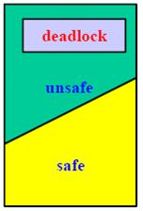
Safe, Unsafe & Deadlock State

Slide 18
Avoidance Algorithms
Single instance of a resource type
Use a resource-allocation graph
Multiple instances of a resource type
Use the banker’s algorithm

Slide 19
Resource-Allocation Graph Scheme
Claim edge P_{i} → R_{j} indicated that process P_{i} may request resource R_{j}; represented by a dashed line
Claim edge converts to request edge when a process requests a resource
Request edge converted to an assignment edge when the resource is allocated to the process
When a resource is released by a process, assignment edge reconverts to a claim edge
Resources must be claimed a priori in the system

Slide 20
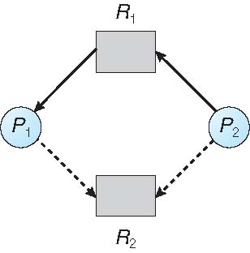
Resource-Allocation Graph

Slide 21
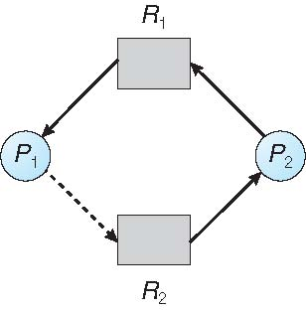
Unsafe State In Resource-Allocation Graph

Slide 22
Resource-Allocation Graph Algorithm
Suppose that process P_{i} requests a resource R_{j}
The request can be granted only if converting the request edge to an assignment edge does not result in the formation of a cycle in the resource allocation graph

Slide 23
Banker’s Algorithm
Multiple instances
Each process must a priori claim maximum use
When a process requests a resource it may have to wait
When a process gets all its resources it must return them in a finite amount of time

Slide 24
Data Structures for the Banker’s Algorithm
Let n = number of processes, and m = number of resources types.
Available: Vector of length m. If available [j] = k, there are k instances of resource type R_{j} available
Max: n x m matrix. If Max [i,j] = k, then process P_{i} may request at most k instances of resource type R_{j}
Allocation: n x m matrix. If Allocation[i,j] = k then P_{i} is currently allocated k instances of R_{j}
Need: n x m matrix. If Need[i,j] = k, then P_{i} may need k more instances of R_{j} to complete its task
Need [i,j] = Max[i,j] – Allocation [i,j]

Slide 25
Banker’s Algorithm – Safety Algorithm
1. Let Work and Finish be vectors of length m and n, respectively.
Initialize Work = Available and Finish[i]=False for i=0,1,2……,n-1
2. Find an index i such that both
Finish[i] = = False
Need_{i} < Work
If No such i exists, go to step 4.
3. Work = Work + Allocation_{i}
Finish[i] = True
Go to Step 2.
4. If Finish[i] = = true for all i, then the system is in a Safe State else unsafe.

Slide 26
Banker’s Algorithm – Resource Request Algorithm
If Request_{i} < Need_{i}, go to step 2. Otherwise, raise an error condition, since the process has exceeded its maximum claim.
If Request_{i} < Available, go to step 3. Otherwise, P_{i} must wait, since the resources are not available.
3. Have the system pretend to have allocated the requested resources to process P_{i} by modifying the state as follows:
Available = Available – Request_{i}
Allocation_{i} =Allocation_{i} + Request_{i}
Need_{i} = Need_{i} - Request_{i}
After this safety algorithm is called.

Slide 27
Example of Banker’s Algorithm
5 processes P₀ through P₄;
3 resource types:
A (10 instances), B (5instances), and C (7 instances)
Snapshot at time T₀:
Allocation Max Available
A B C A B C A B C
P₀ 0 1 0 7 5 3 3 3 2
P₁ 2 0 0 3 2 2
P₂ 3 0 2 9 0 2
P₃ 2 1 1 2 2 2
P₄ 0 0 2 4 3 3

Slide 28
Example (Cont.)
The content of the matrix Need is defined to be Max – Allocation
Need
A B C
P₀ 7 4 3
P₁ 1 2 2
P₂ 6 0 0
P₃ 0 1 1
P₄ 4 3 1
The system is in a safe state since the sequence < P₁, P₃, P₄, P₂, P₀> satisfies safety criteria

Slide 29
Example: P₁ Request (1,0,2)
Process P1 requests for (1 0 2). Check that Request₁ ≤ Available (that is, (1,0,2) ≤ (3,3,2) ⇒ true
Allocation Need Available
A B C A B C A B C
P₀ 0 1 0 7 4 3 2 3 0
P₁ 3 0 2 0 2 0
P₂ 3 0 2 6 0 0
P₃ 2 1 1 0 1 1
P₄ 0 0 2 4 3 1
Executing safety algorithm shows that sequence < P₁, P₃, P₄, P₀, P₂> satisfies safety requirement.
Assuming system is in this state, answer the following:
Can request for (3,3,0) by P₄ be granted?
Can request for (0,2,0) by P₀ be granted?

Slide 30
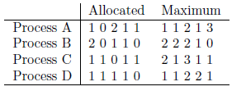
Question 1
A system with 4 processes and 5 allocatable resources are shown:
Suppose the currently available vector is (0 0 x 1 1). What is the smallest value of x for which this is safe? ALSO, give the order in which these can finish with this value of x.

Slide 31
Question 1
If in the previous snapshot of the system, allocated and maximum vector for Process C becomes 1 1 0 1 0 and 2 1 3 1 0, what is the change in answer?

Slide 32
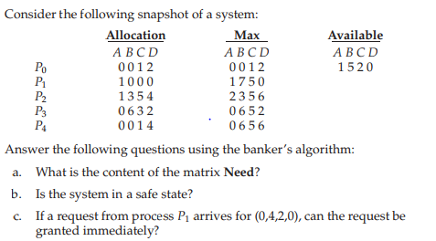
Question 2

Slide 33
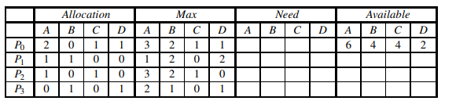
Question 3
Consider the following snapshot of a system in which four resources A, B, C and D area available. The system contains a total of 6 instances of A, 4 of resource B, 4 of resource C, 2 resource D.
Calculate Need Matrix
Is the system in a safe state? Why or why not?
Is the system deadlocked? Why or why not?
If a request from P3 arrives for (2,1,0,0), can the request be granted immediately?

Slide 34
Deadlock Detection
Allow system to enter deadlock state
Detection algorithm
Recovery scheme

Slide 35
Single Instance of each Resource Type
Maintain wait-for graph
Nodes are processes.
P_{i} → P_{j} if P_{i} is waiting for P_{j}.
Periodically invoke an algorithm that searches for a cycle in the graph.

Slide 36
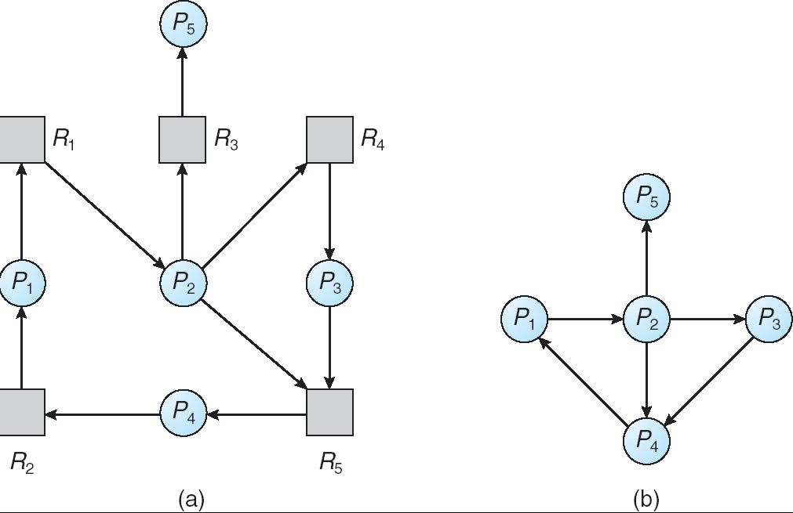
RAG & Wait For Graph

Slide 37
Several Instances of resource Type
Available: A vector of length m indicates the number of available resources of each type.
Allocation: An n x m matrix defines the number of resources of each type currently allocated to each process.
Request: An n x m matrix indicates the current request of each process. If Request [ij] = k, then process Pi is requesting k more instances of resource type. Rj.

Slide 38
Deadlock Detection
1. Let Work and Finish be vectors of length m and n, respectively.
Initialize Work = Available. For i=0,1,2……,n-1, if Allocation_{i} Not equal
to ZERO, then Finish[i] = False; Otherwise, Finish[i] = True
2. Find an index i such that both
Finish[i] = = False
Request_{i} < Work
If No such i exists, go to step 4.
3. Work = Work + Allocation_{i}
Finish[i] = True
Go to Step 2.
4. If Finish[i] = = false for some i, then the system is in Deadlock State.

Slide 39
Example of Detection Algorithm
Five processes P₀ through P₄; three resource types A (7 instances), B (2 instances), and C (6 instances)
Snapshot at time T₀:
Allocation Request Available
A B C A B C A B C
P₀ 0 1 0 0 0 0 0 0 0
P₁ 2 0 0 2 0 2
P₂ 3 0 3 0 0 0
P₃ 2 1 1 1 0 0
P₄ 0 0 2 0 0 2
Sequence <P₀, P₂, P₃, P₁, P₄> will result in Finish[i] = true for all i

Slide 40
Example (Cont.)
P₂ requests an additional instance of type C
Request
A B C
P₀ 0 0 0
P₁ 2 0 2
P₂ 0 0 1
P₃ 1 0 0
P₄ 0 0 2
State of system?
Can reclaim resources held by process P₀, but insufficient resources to fulfill other processes requests
Deadlock exists, consisting of processes P₁, P₂, P₃, and P₄

Slide 41
Recovery from Deadlock – Process Termination
Abort all deadlocked processes.
Abort one process at a time until the deadlock cycle is eliminated.
In which order should we choose to abort?
Priority of the process.
How long process has computed, and how much longer to completion.
Resources the process has used.
Resources process needs to complete.
How many processes will need to be terminated.

Slide 42
Recovery from Deadlock – Resource Preemption
Selecting a victim – minimize cost.
Rollback – return to some safe state, restart process for that state.
Starvation – same process may always be picked as victim, include number of rollback in cost factor.

Slide 43
Question 4
In a real computer system, neither the resources available nor the demands of processes for resources are consistent over long periods(months). Resources break or are replaced, new processes come and go, new resources are bought and added to the system. If deadlock is controlled by the banker's algorithm, which of the following changes can be made safely(without introducing the possibility of deadlock), and under what circumstances?
a. Increase Available(new resources added)
b. Decrease Available(resource permanently removed from system)
c. Increase Max for one process(the process needs more resources than allowed, it may want more)
d. Decrease Max for one process(the process decides it does not need that many resources)
e. Increase the number of processes
f. Decrease the number of processes

Slide 44
Question 5
Consider a system consisting of m resources of the same type being shared by n processes. A process can request or release only one resource at a time. Show that the system is deadlock free if the following two conditions hold:
a. The maximum need of each process is between one resource and m resources.
b. The sum of all maximum needs is less than m + n.

Slide 45
Question 6
A computer has six tape drives, with n processes competing for them. Each process may need two drives. What is the maximum value of n for the system to be deadlock free?

Slide 46
Question 7
A computer system has 6 tape drives with n processes competing for them. Each process may need 3 tape drives. The maximum value of n for which the system is guaranteed to be deadlock free is ________________

Slide 47
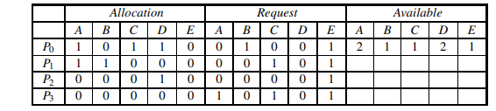
Question 8
Consider the following snapshot of a system in which five resources A, B, C, D and E are available. The system contains a total of 2 instances of A, 1 of resource B, 1 of resource C, 2 resource D and 1 of resource E.
Do the following problems:
• Convert this matrix representation to a resource allocation graph.
• Use the deadlock detection algorithm to determine whether the system contains a deadlock. Which processes are involved in the deadlock?

